Slide 1
Machine Learning Project
Seth Tomy and Mark Lynch

Slide 2





Languages, Libraries and Notebooks

Slide 3
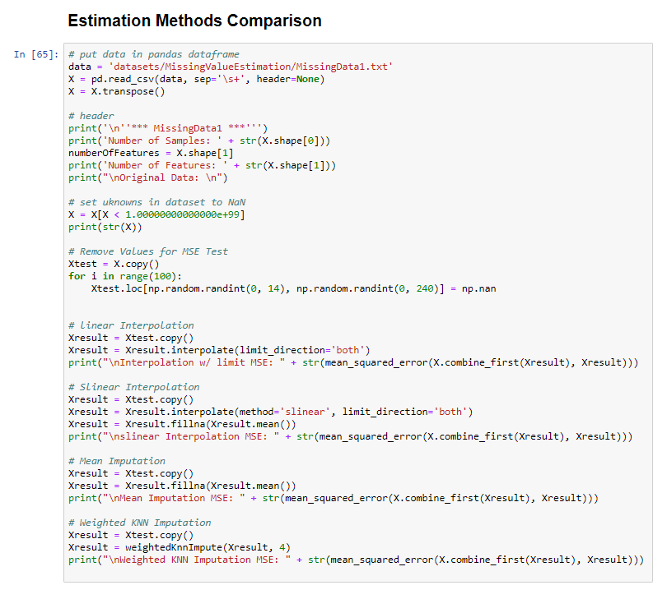
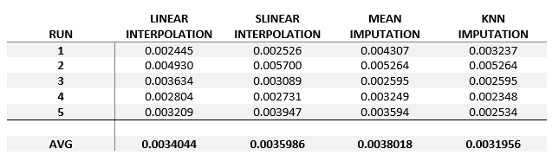
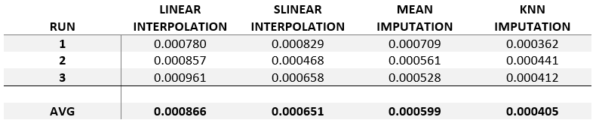
Missing Value Estimation
Mean Squared Error on MissingData1.txt
Mean Squared Error on MissingData2.txt

Slide 4
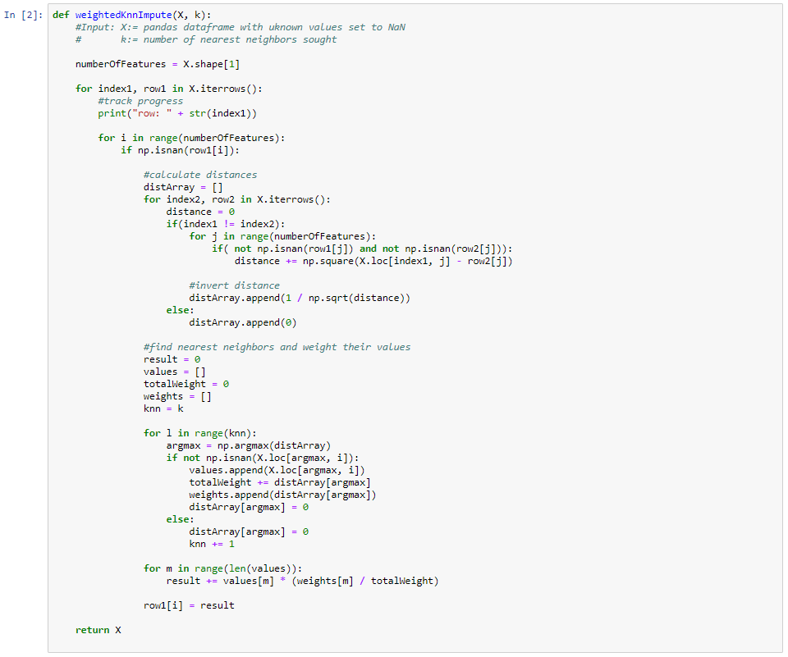
Weighted KNN Imputer

Slide 5
Classification: Our Strategy
90% Train, 10% Test
'Brute Force' approach
Identify best algorithm(s)
Identify range of hyperparameters, tune on range
Ensemble

Slide 7
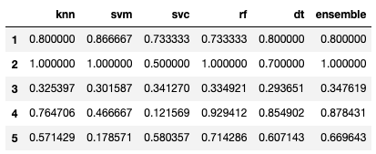
Validation Results

Slide 8
Questions?

